Slide 1


Sterling Industries

Slide 2
Our range of manufacturing processes
Inhouse Tooling
Precision turning
Stampings
Forgings
Weldments

Slide 3
Our range of manufacturing processes
Inhouse Tooling
Precision turning
Stampings
Forgings
Weldments
Sterling Industries can provide parts requiring Machining, Stamping, Forging & Welding as a combination or individual processes. Utilizing the benefit of it’s In-house Tool Room, helps provide control on quality and a faster turnaround for mission-critical applications. Parts can be provided in steel, alloy steel used typically in heavy lifting and industrial equipment. Accuracy can be provided within .001" tolerances

Slide 4
Precision Turning

Slide 5
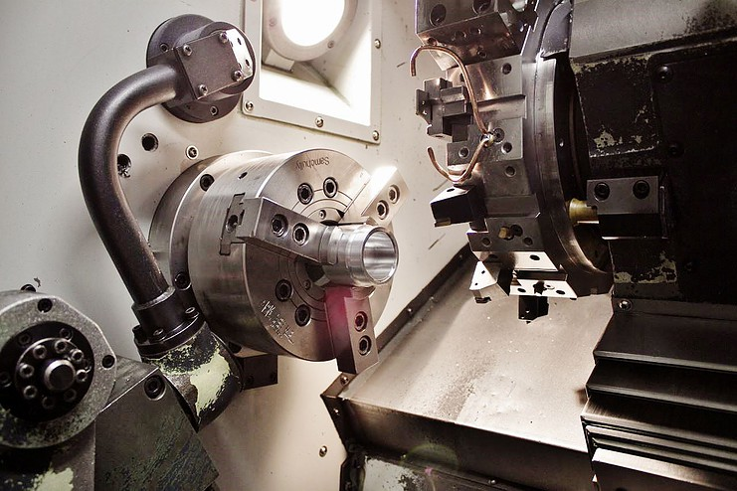
CNC Machining
Sterling Industries can provide machined pins and shafts of steel and stainless steel alloys typically from 7/16'' diameter to 10'' diameter for use in heavy lifting and industrial equipment. Typically turned to within .001" tolerances

Slide 6
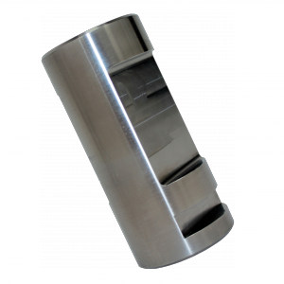
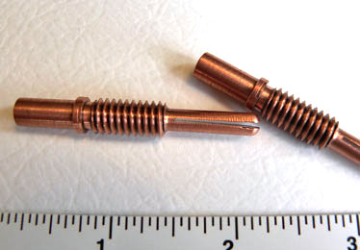
Pins & Shafts
Sterling Industries can provide pins and shafts of steel and stainless steel alloys typically from 7/16'' diameter to 10'' diameter, to exacting tolerances (typically 0.002 to 0.005 TIR), in a variety of materials, from tool-steel to copper, brass and alloy steels.

Slide 7
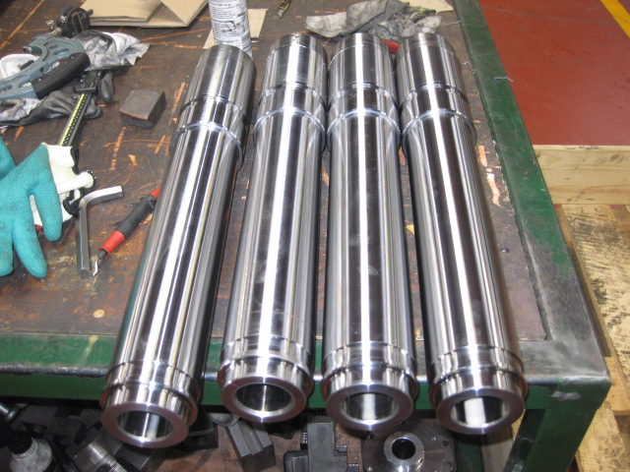
Pins & Shafts (continued)
Typically turned to within .001" tolerances, many pins and shafts also include cross holes or other milled details machined in the same setup on lathes with live tooling.

Slide 8
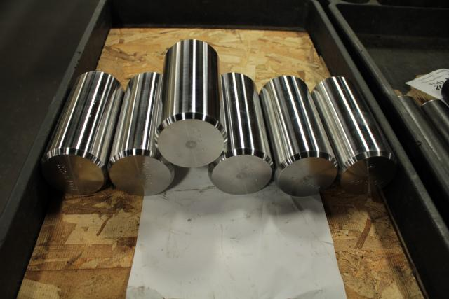
Pins & Shafts (continued)
Sharp internal and external beveled edges and corners.

Slide 9
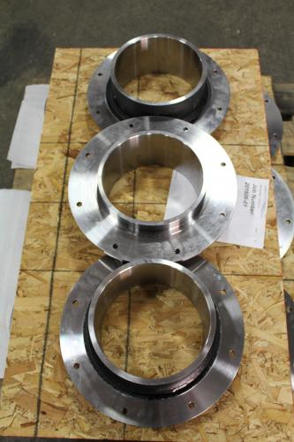
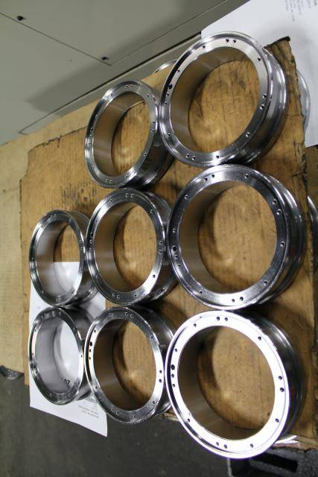
Flanges & Bearing Plates
Ability to provide ‘square corners’. An option to provide angular chamfers, instead of a radius, so important in high pressure sealing applications.

Slide 10
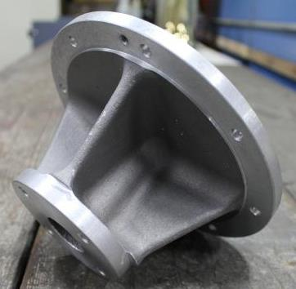
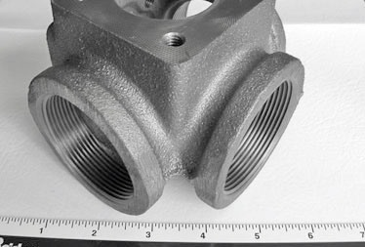
Machined Castings
We machine gray iron, stainless and aluminum castings in addition to the usual billet and bar stock. Our extensive experience in this can save you money.

Slide 11
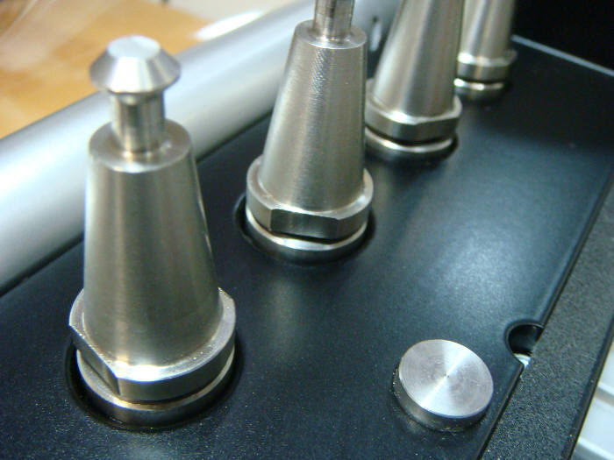
Conical Bushes
CNC profile machining includes advanced production cutting operations that ensures parts are held in place and accurately machined, with high quality edges and corner detail.

Slide 12
Stamped Parts

Slide 13
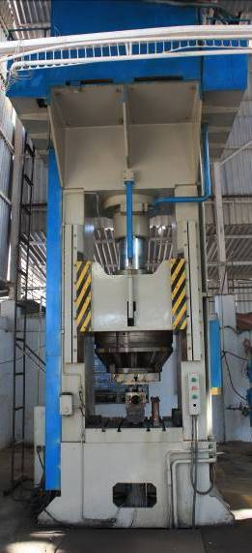
Stamping Presses
40” x 40” x 25 ½” Stroke x 27” Shut Height. Top cylinder 300 Ton, Bottom Cylinder 100 Ton, Maximum capacity 300 Tons.

Slide 14
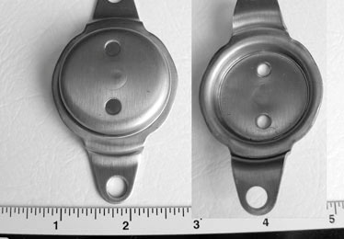
Stamped Parts
Custom parts made to your requirements and specifications with “hard tooling”. Using latest, state-of-the-art 3D Solid CAD/CAM modeling, making it easy to iterate through different design and manufacturing options. Maximum capacity 300 Tons.

Slide 15
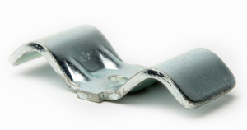
Stamped Parts
3in x 1.25in, Material HRPO 0.120 inch thick, Zinc plated, Metal stamping clamp bracket, Customer: Industrial

Slide 16
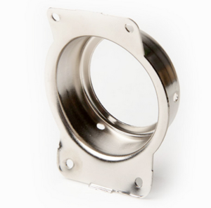
Stamped Parts
2.5in x 3.25in, Material 303 Stainless Steel,
Metal stamping hose bracket, Customer: Washing Machine

Slide 17
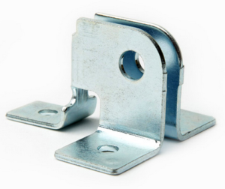
Stamped Parts
3.00in x 3.25in x 3.00in Material HRPO 0.090 in thick,
Garage Door Bracket, Customer: Industrial

Slide 18
Forged Parts

Slide 19
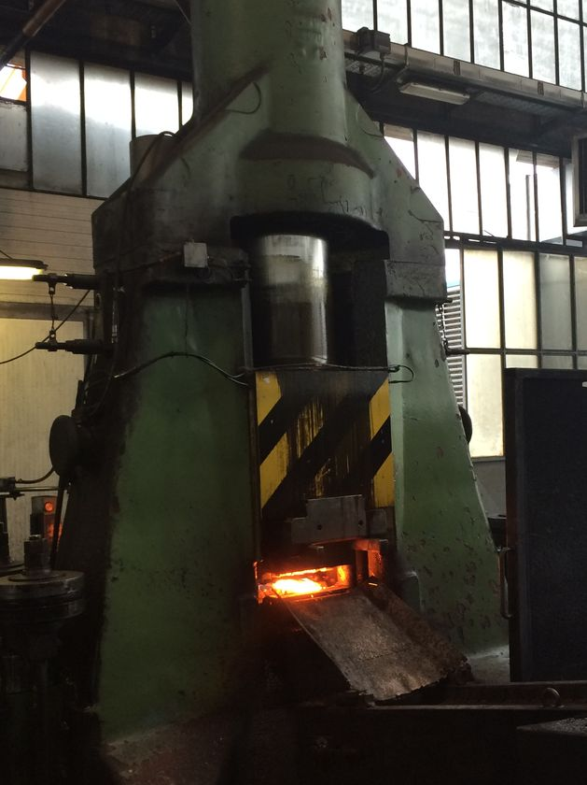
Forging Drop Hammer
Capacity 2 Tons
Stroke per minute: 42 – 100
Slide Stroke: 25 inches
Material traceability is ensured with chemical and physical material certifications held on file for all jobs.

Slide 20
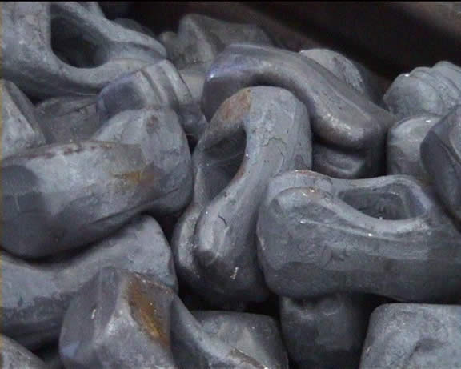
Forged Parts
3.00in x 1.75in x 2.00in Material SAE 1045 Hot Forged,
Link nuts, Customer: Industrial

Slide 21
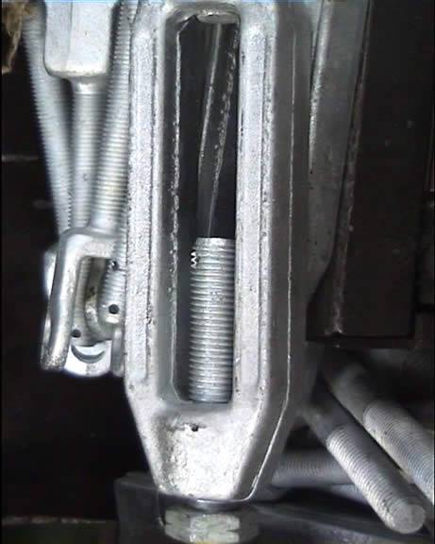
Forged Parts
12.00in x 3.25in x 1.50in Material SAE 1040,
Forged Nut, Customer: Industrial

Slide 22
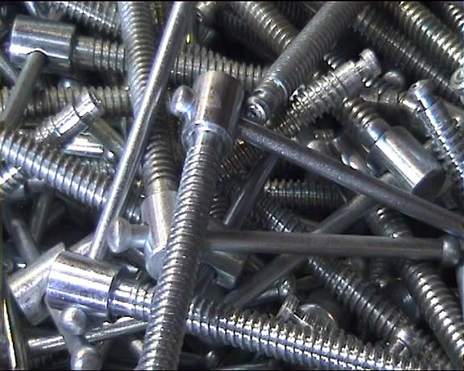
Forged Parts
10.00in x 5/8in x 6.00in Material SAE 1541 Quench & Tempered with Zinc Plating
Vise handles, Customer: Industrial

Slide 23
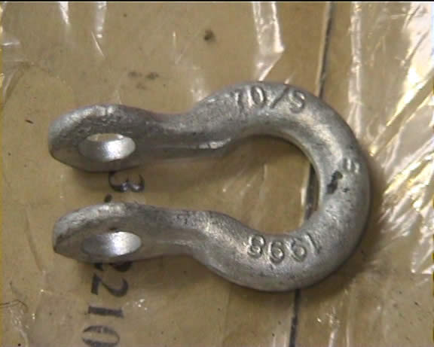
Forged Parts
6.00in x 4.25in x 1.00in Material SAE 1045 Quench & Tempered,
Lifting Hook, Customer: Industrial

Slide 24
Weldments

Slide 25
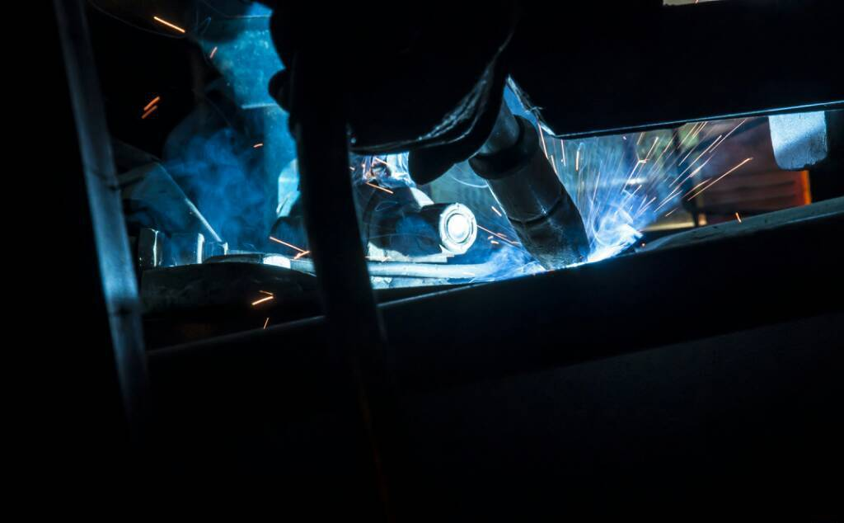
Automated Welding

Slide 26
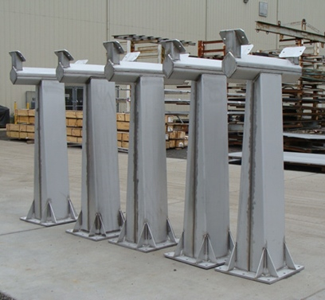
Specialities Fabrication
Material traceability is ensured with chemical and physical material certifications held on file for all jobs.

Slide 27
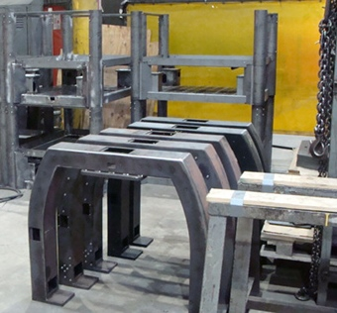
Specialities Fabrication
Material traceability is ensured with chemical and physical material certifications held on file for all jobs.

Slide 28
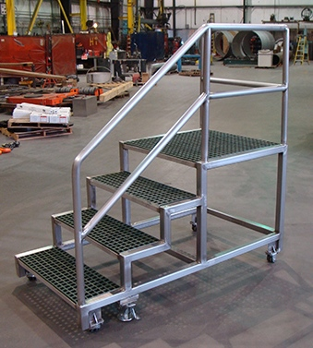
Specialities Fabrication
Material traceability is ensured with chemical and physical material certifications held on file for all jobs.

Slide 29
In-house Tool Room

Slide 30
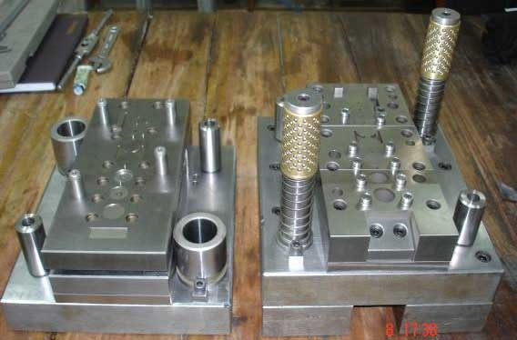
Tool Room
Material traceability is ensured with chemical and physical material certifications held on file for all jobs.

Slide 31
Quality Assurance
We are registered to ISO/TS:16949 & ISO 9000, your part will follow this route:
Final Despatch
PPAP
Initial Sampling or Prototyping
Design Review

Slide 32
Design Review
Referencing the final part to which material grade, how the process is set up, what the packaging will withstand is one of the most important elements of the process. Careful attention at this stage will determine a very smooth and enjoyable experience. Few samples meeting your specifications will be cut out and submitted to you for onward inspection by your Inspection & Quality Control, allowing you to quickly check the results before we embark on making your parts. Any of these values, inputs can be easily changed to ensure you have 100% control over the output.

Slide 33
Initial Sampling
Referencing the final part to which material grade, how the process is set up, what the packaging will withstand is one of the most important elements of the process. Careful attention at this stage will determine a very smooth and enjoyable experience. Few samples meeting your specifications will be cut out and submitted to you for onward inspection by your Inspection & Quality Control, allowing you to quickly check the results before we embark on making your parts. Any of these values, inputs can be easily changed to ensure you have 100% control over the output.

Slide 34
Production Part Approval process (PPAP)
As per ISO/TS-16949 & ISO 9000 Quality requirements, after initial sample acceptance, we will produce the part on production machines and processes, utilizing production tooling, gauging and fixtures. A summary of form, fit, function is displayed in the PPAP document and submitted to you along with actual production parts for onward acceptance by your Inspection and Quality Control, allowing you to quickly check the results. Only after your sign-off on the PSW document, do we embark on making your parts, ensuring you have 100% control over our manufacturing and quality output.

Slide 35
Final Despatch
Referencing the final part to how the process is set up is one of the most important elements of the process. A summary of form, fit, function is displayed in the PPAP document and submitted to you along with actual production parts for your Inspection and Quality Control, allowing you to quickly check the results before we embark on making your parts. Any of these values, inputs can be easily changed to ensure you have 100% control over our manufacturing and quality output.

Slide 36
And Much More ...
We have only been able to give you a brief overview of some of our manufacturing capabilities here. To really understand the speed, flexibility and full scope of what we do, please ask for a one-on-one meeting and allow us to present ourselves.
What sets Sterling Industries apart from the multitude of typical suppliers is the ability to create a bespoke solution; option to preserve confidentiality, infinite variety of parts with a combination of processes at prices which meet or exceed your price targets.
Live interaction will get you understood fast and our team of knowledgeable engineers will be with you throughout the process to get your order up and running quickly.
Finally, if you have reached this far, we'd like to thank you for your interest in Sterling Industries and encourage you to ...
Shoot us an RFQ NOW and see what Sterling Industries can do for you!

